Slide 1
A
Case Study
To understand Consumer Behaviour

Slide 2
Agenda
01
Requirement
05
Analyzing and Visualizing
02
Data Set First View
06
Observations
03
Assumptions
07
Recommendations
04
Data Cleaning
08
Thank You

Slide 3
PROBLEM STATEMENT
The Objective of this case study is to give 3 main recommendations to the CEO of the company based on your analysis.
Visualization to understand customer behavior and key takeaways

Slide 4
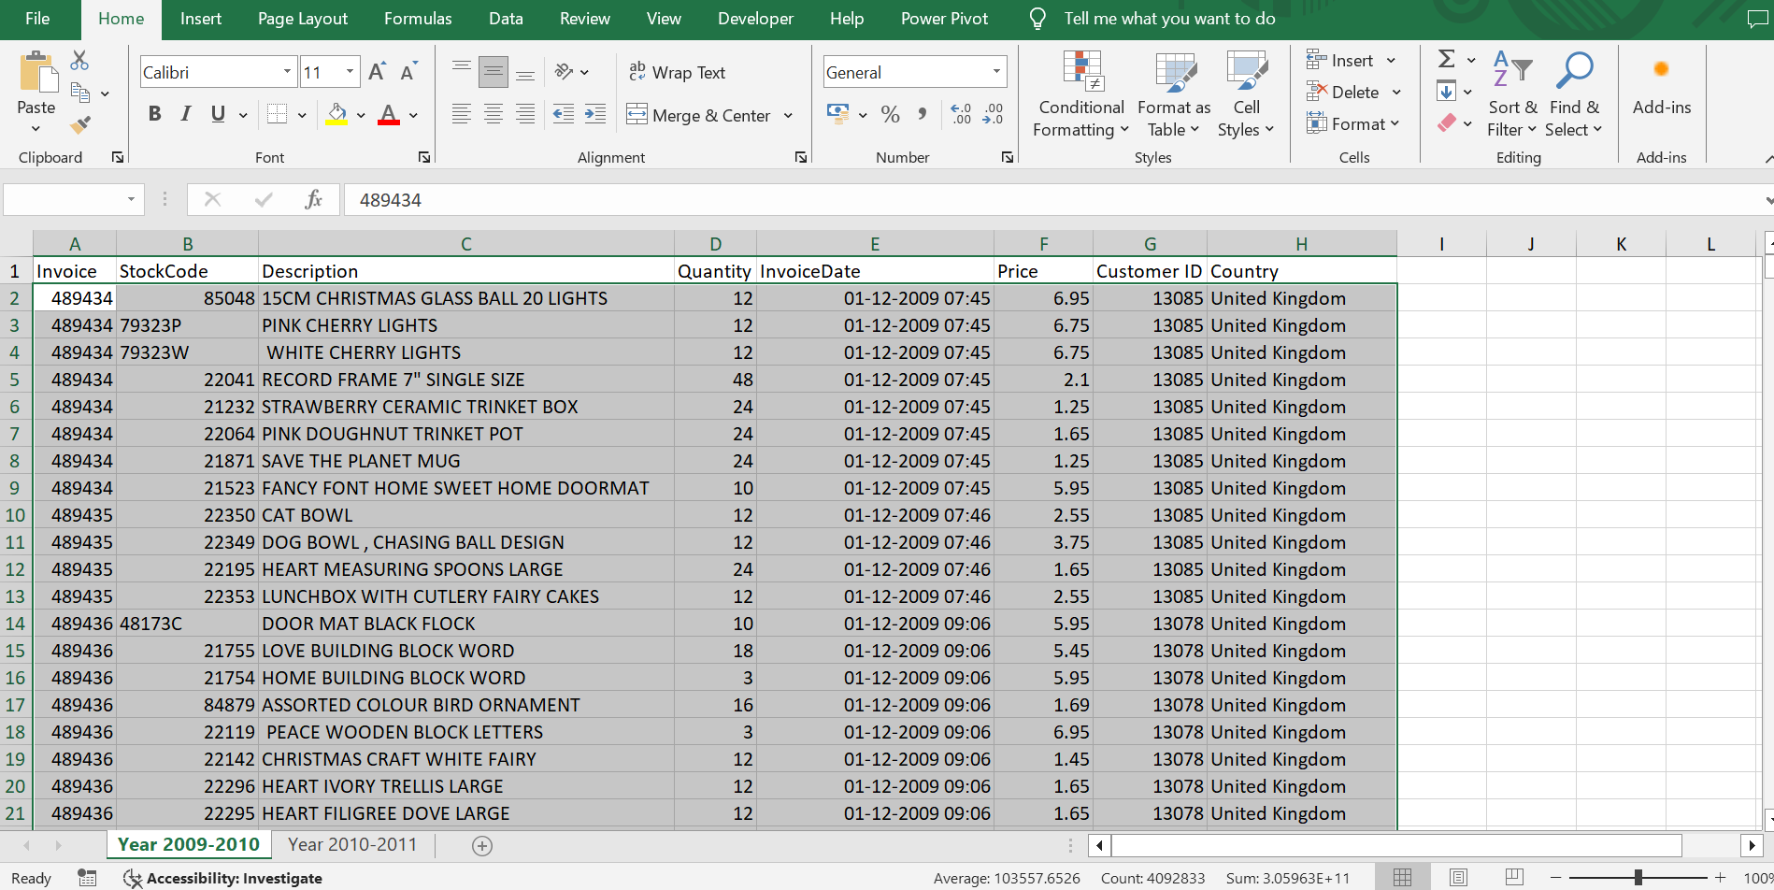
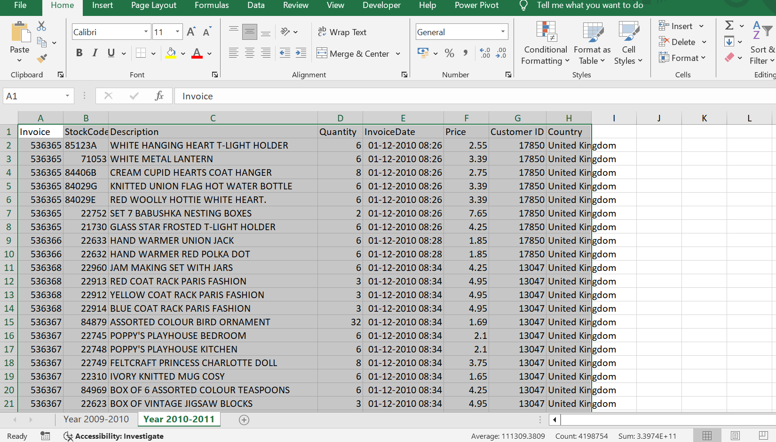
DATA SET FIRST VIEW
2009-2010
2010-2011

Slide 5
ASSUMPTIONS
There are many Items or products where no name has been mentioned and even price is zero like check, found, counted, dotcom sales, ebay sales, showroom, sold as sets, ?? , manual, found some more on shelf, Found in w/hse, Found by jackie, mailout, michel oops, historic computer difference?....se etc. categorized as Product details not found
Some Items are crushed, broken, breakages, cracked, damages, faulty, wet damaged, rusty, Thrown away-rusty, wet/rusty, rusty throw away, rusty thrown away, incorrectly made-thrown away, water damaged, damages wax, Unsaleable, destroyed, Printing smudges/thrown away, are considered as Damaged.
Some Items are wrongly sold sets, wrong barcode (22467),wrongly sold (22719) barcode, wrongly marked. 23343 in box, stock creditted wrongly, wrongly coded 20713, wrongly coded-23343, wrongly marked 23343, 20713 wrongly marked, wrongly coded 23343, wrongly coded 20713, Wrongly mrked had 85123a in box, wrongly marked carton 22804, sold with wrong barcode, came coded as 20713, code mix up? 84930, incorrectly credited C550456 see 47, incorrectly credited C550456 see 47, incorrectly put back into stock, Incorrect stock entry, ?display?, mix up with c, etc are considered as Wrong Entry
Some items are like adjust, reverse previous adjustment, temp adjustment, OOPS ! adjustment, Amazon Adjustment, re-adjustment, dotcom adjust, taig adjust, reverse 21/5/10 adjustment, reverse 21/5/10 adjustment all are considered as Adjustment as no specific product item was mention and prices of these items were zero and negative too.
Some Items are lost, missing, can't find, missing?, ?? missing, ????missing, ???missing, lost in space are considered as Missing
Some items like mouldy, WET/MOULDY, are considered as Defective

Slide 6
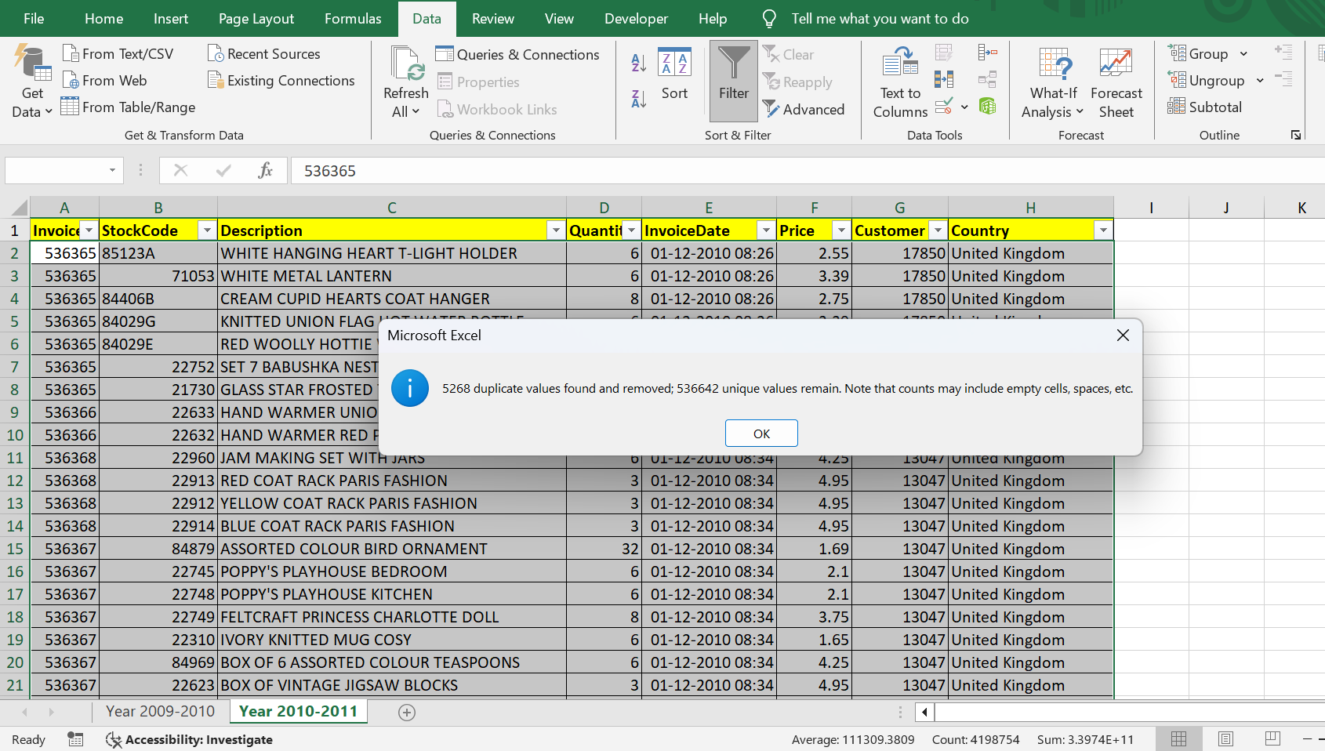
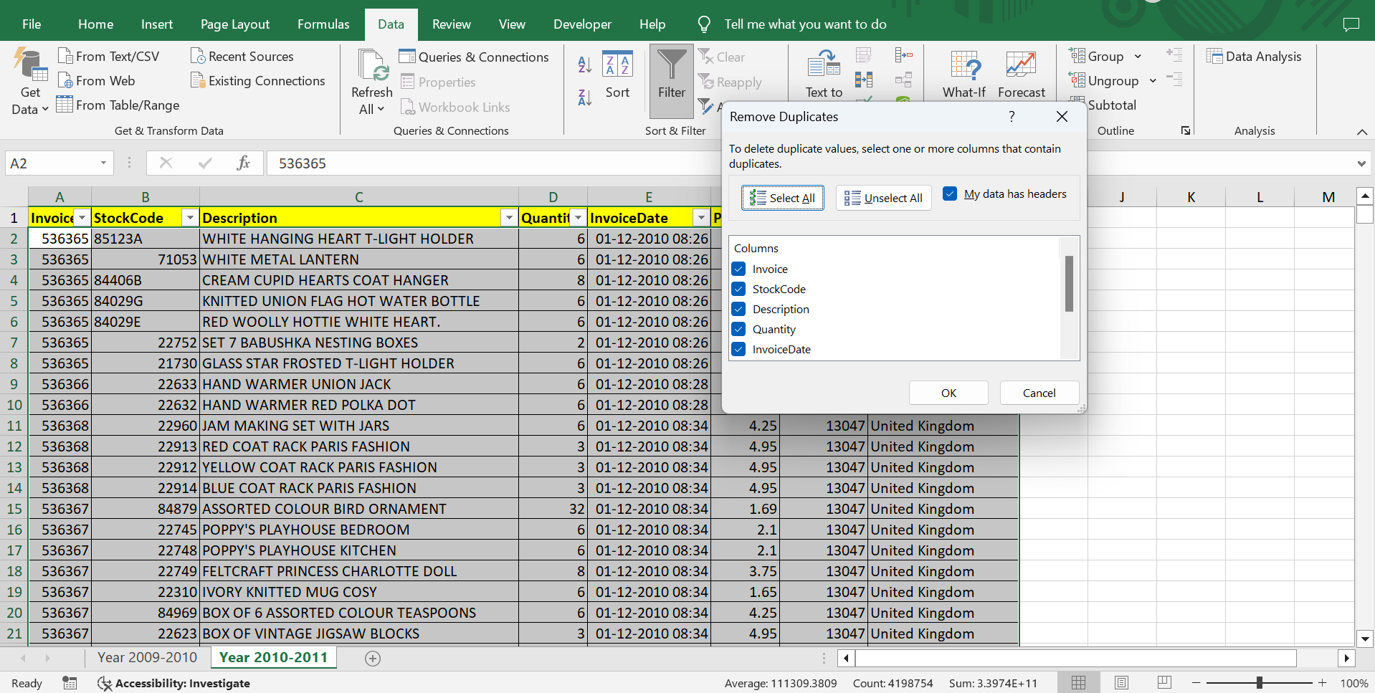
DATA CLEANING
2009-2010
Total data was - 5,25,461
Final data after cleaning - 5,15,618
2010-2011
Total data was - 5,41,910
Final data after cleaning - 5,35,120

Slide 7
ANALYZING AND VISUALIZING
Revenue
95,05,776
97,26,025
2.32%
Total Sales 2009-2010
Total Sales 2010-2011
Growth rate.
THIS GROWTH REFLECTS COMPANY CONTINUED EFFORTS AND THE EFFECTIVENESS OF THEIR STRATEGIES IN DRIVING FINANCIAL PERFORMANCE..

Slide 8
Yearly and Quaterly Sales(2009-2010)
Understand the growth curve
THROUGHTOUT THE YEAR CONSISTENCE PERFORMANCE BY THE COMPANY, IN THE LAST QUARTER IT IS 36.33 %
IF WE SEE FROM DEC 2009 TO DEC 2010 THEN ITS A 255.82% GROWTH BY COMPANY

Slide 9
Yearly and Quaterly Sales(2010-2011)
And the growth continuse
THROUGHTOUT THE YEAR CONSISTENCE PERFORMANCE BY THE COMPANY, IN THE LAST QUARTER IT IS 24.34 %
IF WE SEE FROM DEC 2009 TO DEC 2010 THEN ITS A 296.16% GROWTH BY COMPANY
AS COMPARED TO LAST YEAR IN LAST QUARTER IT WAS 36.33%, ITS A DOWNFALL COMPANY NEED TO SEE THE REASONS BEHIND IT

Slide 10
PRODUCT WISE SALES
THE FIRST POINT
REGENCY CAKESTAND 3 TIER HAS BEEN THE TOP SELLING PRODCUT ACROSS THE TWO YEARS
THE SECOND POINT
THE RISE IN CERTAIN PRODUCTS LIKE DOTCOM POSTAGE HAS SHOWN PROGRESS
ONE FINAL POINT
SOME PRODUCTS ARE A STAPLE LIKE ASSORTED BIRD ORNAMENT, JUMBO STRAWBERRY BAGS

Slide 11
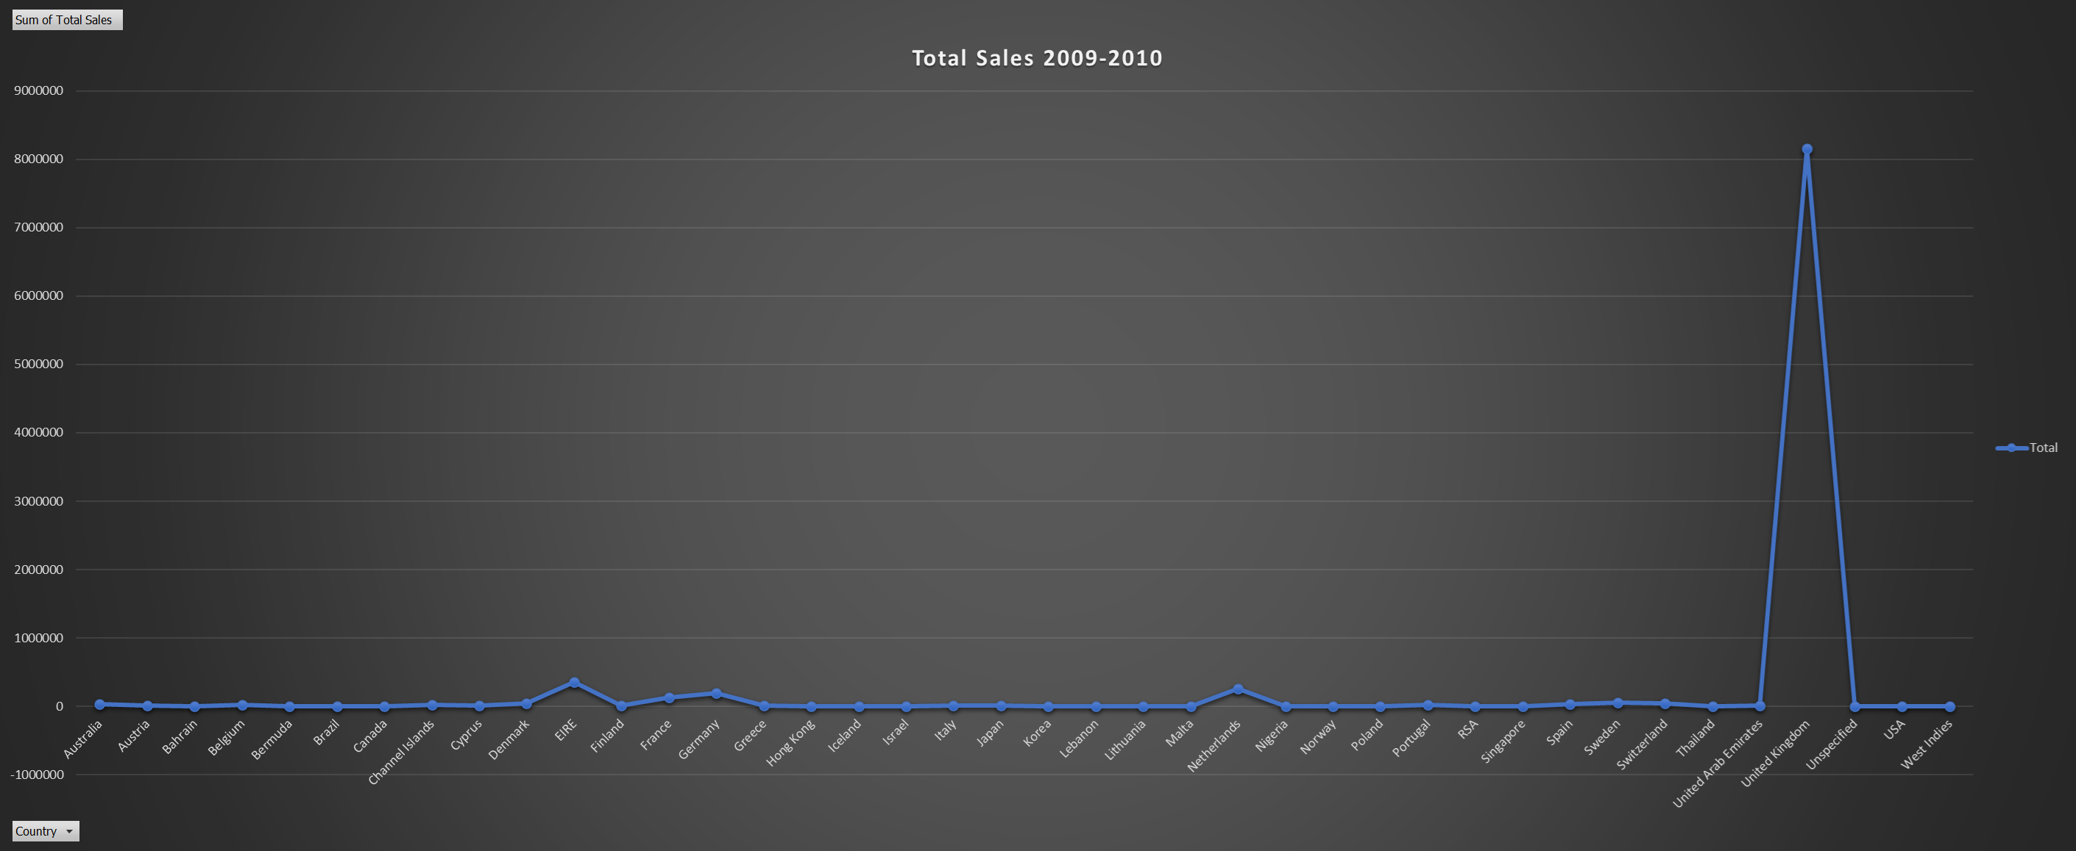
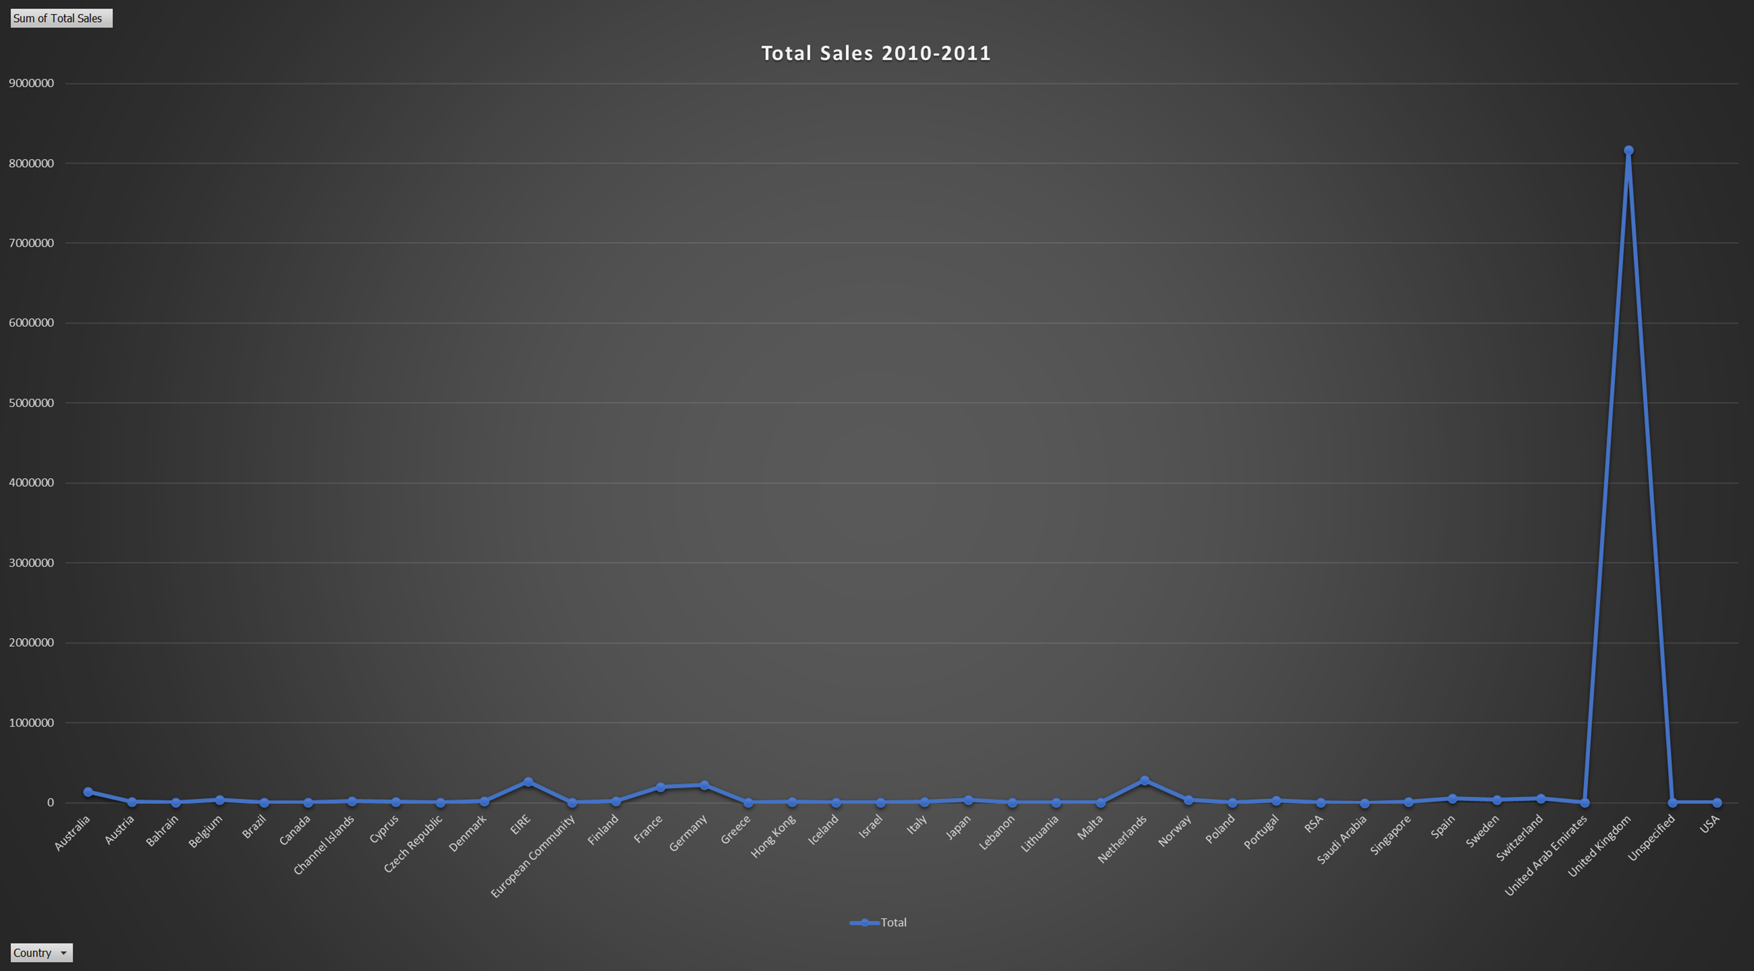
Lets compare the sales in different
countries
2009-2010
The most sales occuring in the United Kingdom, Ireland, France, Germany and Netherlands
2010-2009
We see some new sales in places such as Australia, Spain and additional sales in regions like France showing scopt for expansion

Slide 12
Understanding Sale through the months
2009-2010
2010-2011
Major sales across Oct-Nov as well as some increased sales in the mid months on the year
With another year with similar statistics, advance sales in the months on Oct-Nov to attract addtional sales as well as Promos during the mid months to increase sales then

Slide 13
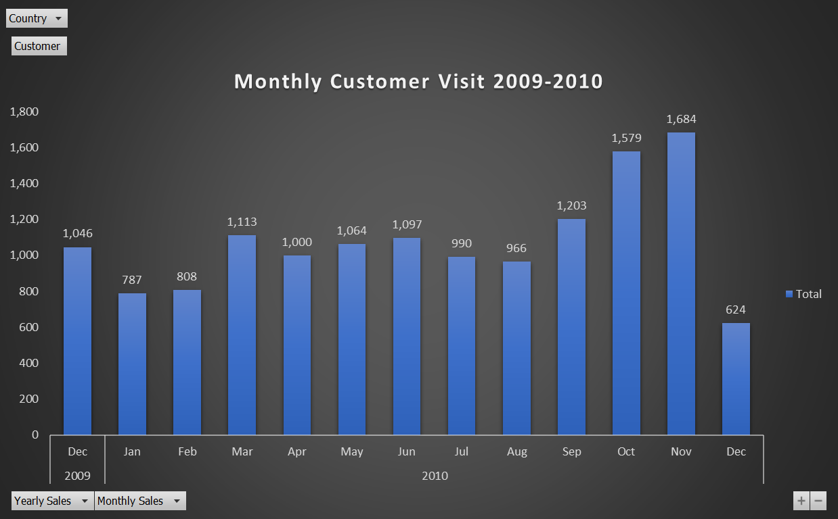
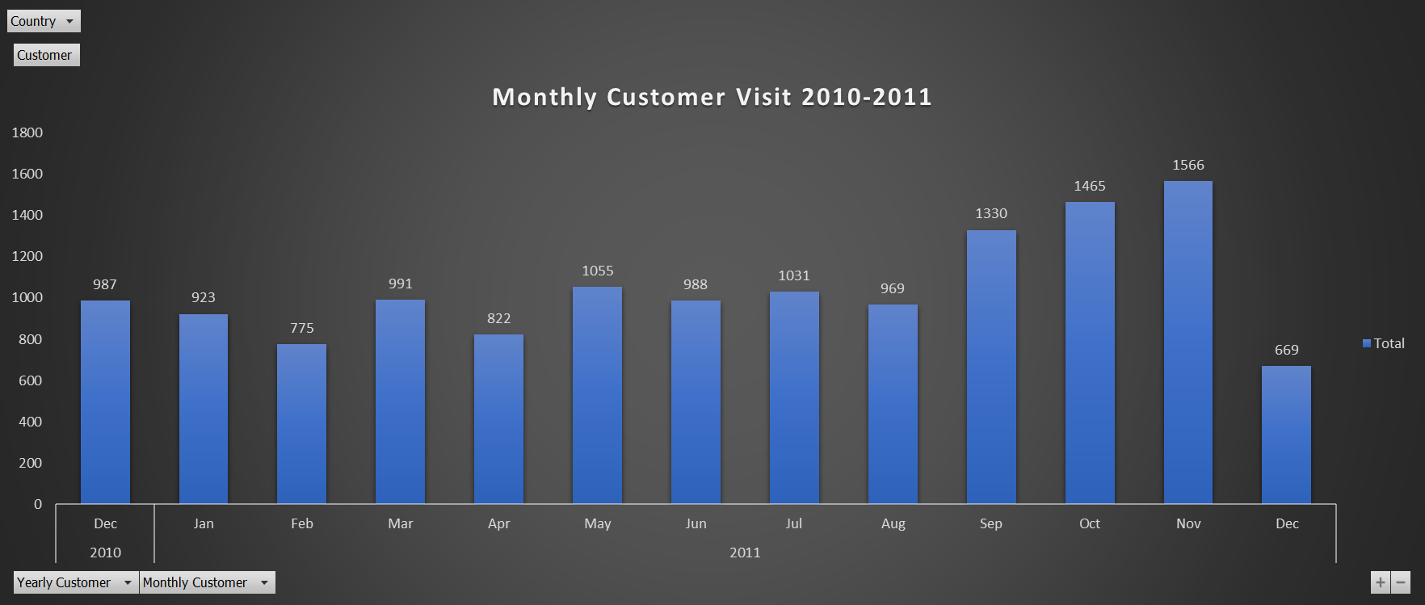
New Footfalls every month
2009-2010
Most customer visit was in November 2010 around 1684 across all countries second highest was in October 2010 around 1579
2010-2011
Most customer visit was in November 2011 around 1566 across all countries second highest was in October 2011 around 1465

Slide 14
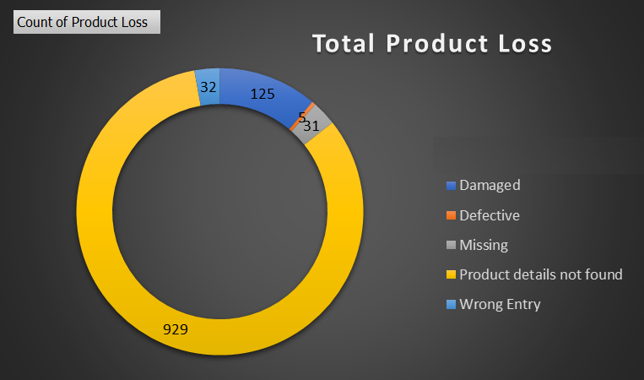
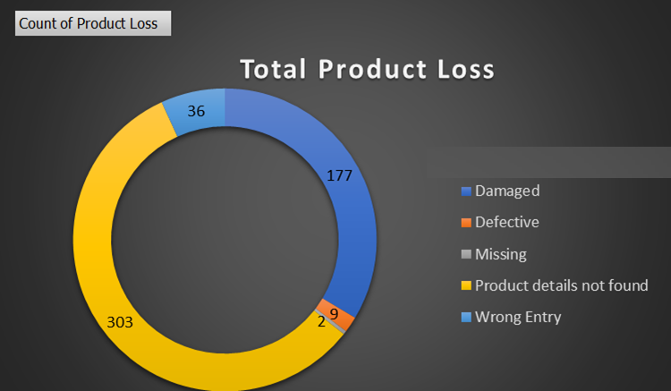
Observations
As compared both the years damaged Products have been increased by 41.6%, defective increased by 80%, Wrong Entry increased by 12.5%
2009-2010
2010-2011

Slide 15
RECOMMENDATIONS
October and November month footfall sales is highest till now in both years, we can increase sales in rest of the months by giving some offers
Need to understand different consumer behavior as different countries have different set of people with different mindset, focus on their taste, style and affordability segment
Need to take some actions on the points mentioned below
a) Damage control as it has increased drastically
b) Recording a transaction is also need to be corrected
c) Defective Items to be returned to vendors or inform them so that it can reduced to some certain level
d) There were 422 products recorded at 0 price in 2009-2010 and 421 products recorded at 0 price in 2010-2011, need to look on priority, as this is Big Revenue Leakage
e) Need to reduce our adjustment and reversal transactions
f) Many products have been sold but there data in which country it is being sold 310 unspecified countries in 2009-2010 & 442 in 2010-2011, it is a Big Revenue Leakage
4. We should increase in footfalls, through means of digital marketing, giving good experience to customers it will lead to recommendation, billboards, Newspaper Marketing, Boucher, social activities etc

Slide 16


